Slide 1
Parables
2024 Quarter 3 Lesson 04
Mark 4

Slide 2
Quarterly: Sabbath Afternoon
For many years scholars have argued over the meaning and interpretation of Jesus’ parables: How to interpret what they mean, why Jesus used them, what kind of lessons they were intended to reveal, and how literally they were to be taken, or whether they were purely allegory, and so forth.

Slide 3
Parable Questions
How to interpret what they mean,
Why Jesus used them,
What kind of lessons they were intended to reveal,
How literally they were to be taken,
Whether they were purely allegory.

Slide 4
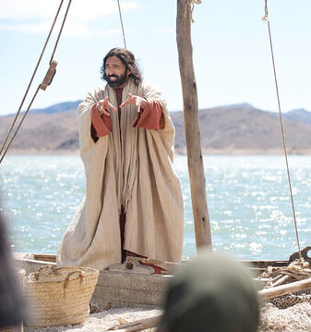
The Sower
Mark 4:1-9
And he began again to teach by the sea side: and there was gathered unto him a great multitude, so that he entered into a ship, and sat in the sea; and the whole multitude was by the sea on the land.

Slide 5
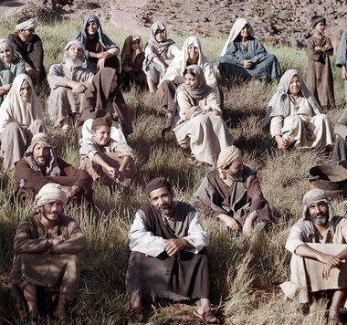
The Sower
Mark 4:2-9
2 And he taught them many things by parables, and said unto them in his doctrine,

Slide 6
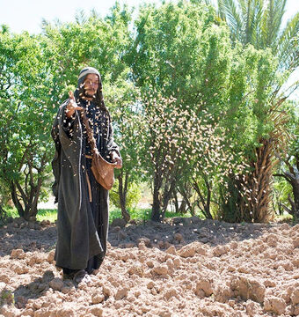
The Sower
Mark 4:3-9
3 Hearken; Behold, there went out a sower to sow:

Slide 7
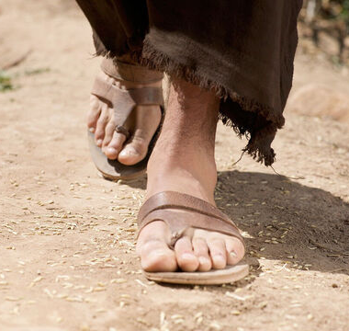
The Sower
Mark 4:4-9
4 And it came to pass, as he sowed, some fell by the way side, and the fowls of the air came and devoured it up.

Slide 8
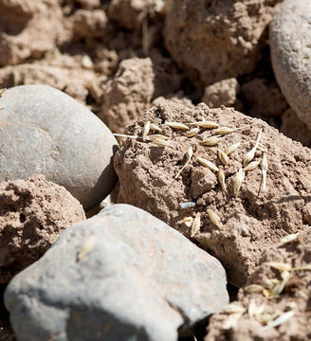
The Sower
Mark 4:5-9
5 And some fell on stony ground, where it had not much earth; and immediately it sprang up, because it had no depth of earth:

Slide 9
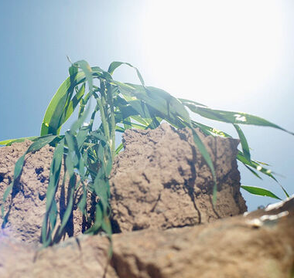
The Sower
Mark 4:6-9
6 But when the sun was up, it was scorched; and because it had no root, it withered away.

Slide 10
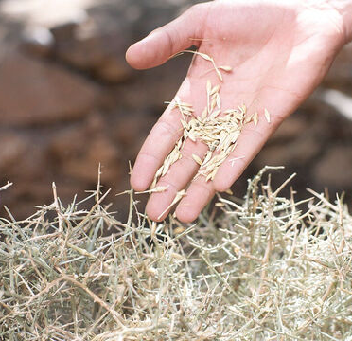
The Sower
Mark 4:7-9
7 And some fell among thorns, and the thorns grew up, and choked it, and it yielded no fruit.

Slide 11
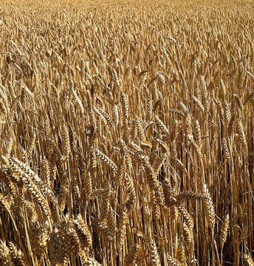
The Sower
Mark 4:8-9
8 And other fell on good ground, and did yield fruit that sprang up and increased; and brought forth, some thirty, and some sixty, and some an hundred.

Slide 12
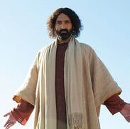
The Sower
Mark 4:9
9 And he said unto them, He that hath ears to hear, let him hear.

Slide 13
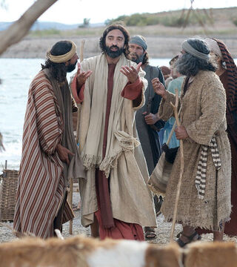
Parables
Mark 4:10-12
10 And when he was alone, they that were about him with the twelve asked of him the parable.

Slide 14
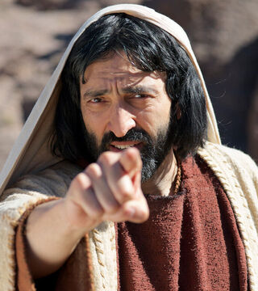
Parables
Mark 4:10-12
11 And he said unto them, Unto you it is given to know the mystery of the kingdom of God: but unto them that are without, all these things are done in parables:

Slide 15
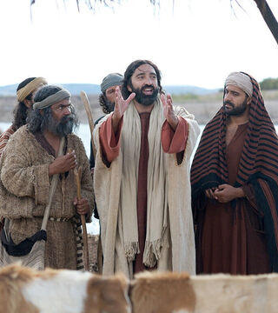
Parables
Mark 4:12
12 That seeing they may see, and not perceive; and hearing they may hear, and not understand; lest at any time they should be converted, and their sins should be forgiven them.

Slide 16
This is quoted from Isaiah 6:10
“
“Make the heart of this people fat, and make their ears heavy, and shut their eyes; lest they see with their eyes, and hear with their ears, and understand with their heart, and convert, and be healed.”
”

Slide 17
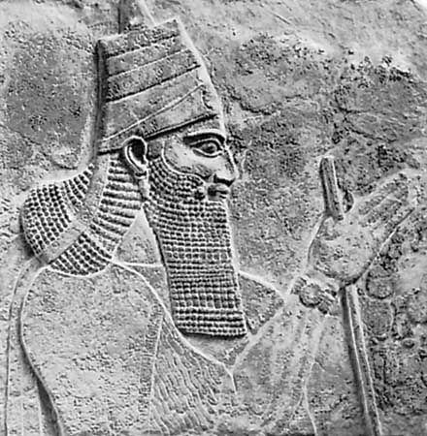
The Throne Room
Isaiah 6:1-10
In the year that king Uzziah died I saw also the Lord sitting upon a throne, high and lifted up, and his train filled the temple.
The time was one of peril and crisis. The mighty Tiglath-pileser III was conquering much of Western Asia. Uzziah, who had led the region’s opposition to Assyrian conquest, was now gone.

Slide 18

The Throne Room
Isaiah 6:2-10
2 Above it stood the seraphims: each one had six wings; with twain he covered his face, and with twain he covered his feet, and with twain he did fly.
3 And one cried unto another, and said, Holy, holy, holy, is the Lord of hosts: the whole earth is full of his glory.

Slide 19
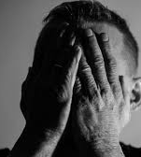
The Throne Room
Isaiah 6:4-10
4 And the posts of the door moved at the voice of him that cried, and the house was filled with smoke.
5 Then said I, Woe is me! for I am undone; because I am a man of unclean lips, and I dwell in the midst of a people of unclean lips: for mine eyes have seen the King, the Lord of hosts.

Slide 20
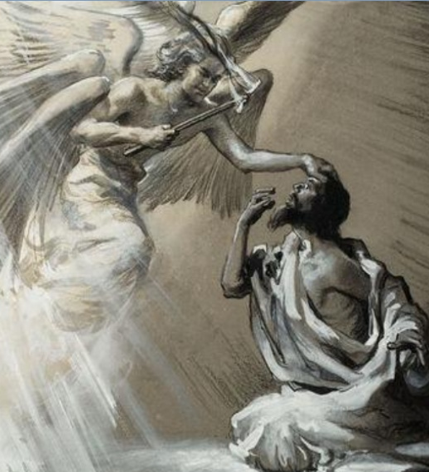
The Throne Room
Isaiah 6:6-10
6 Then flew one of the seraphims unto me, having a live coal in his hand, which he had taken with the tongs from off the altar:
7 And he laid it upon my mouth, and said, Lo, this hath touched thy lips; and thine iniquity is taken away, and thy sin purged.

Slide 21
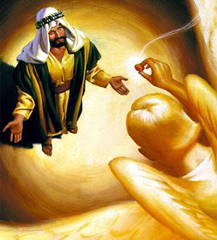
The Throne Room
Isaiah 6:8-10
8 Also I heard the voice of the Lord, saying, Whom shall I send, and who will go for us? Then said I, Here am I; send me.
9 And he said, Go, and tell this people, Hear ye indeed, but understand not; and see ye indeed, but perceive not.

Slide 22
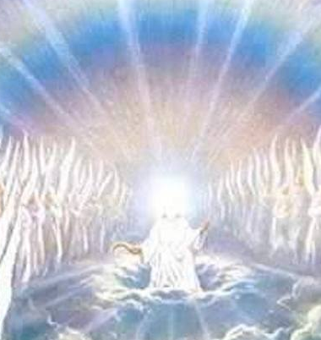
The Throne Room
Isaiah 6:10
10 Make the heart of this people fat, and make their ears heavy, and shut their eyes; lest they see with their eyes, and hear with their ears, and understand with their heart, and convert, and be healed.

Slide 23
SDA Bible Commentary on Matthew 13:15
“
As in Isaiah 6:10, in the New Testament these words are spoken in irony. It was not God’s will that any should be in this condition or that any should fail to understand and be converted. The condition of the Jewish leaders was the natural result of their own conduct and way of life.
”

Slide 24
Christ’s Object Lessons p. 105
“
God does not conceal His truth from men. By their own course of action they make it obscure to themselves. Christ gave the Jewish people abundant evidence that He was the Messiah; but His teaching called for a decided change in their lives.
”

Slide 25
Christ’s Object Lessons p. 105
“
They saw that if they received Christ, they must give up their cherished maxims and traditions, their selfish, ungodly practices. It required a sacrifice to receive changeless, eternal truth. Therefore they would not admit the most conclusive evidence that God could give to establish faith in Christ.
”

Slide 26
Christ’s Object Lessons p. 105
“
“Among the chief rulers also many believed on Him,” we read; “but because of the Pharisees they did not confess Him, lest they should be put out of the synagogue.” John 12:42. They were convinced; they believed Jesus to be the Son of God; but it was not in harmony with their ambitious desires to confess Him.
”

Slide 27
SDA Bible Commentary on Matthew 13:11
“
Only those who “will do his will” can expect to “know of the doctrine” (John 7:17). The perception of truth depends not so much on keenness of intellect as upon sincerity of desire.
”

Slide 28
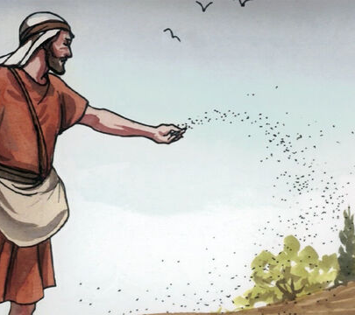
The Parable of the Sower Explained
Mark 4:13-20
13 And he said unto them, Know ye not this parable? and how then will ye know all parables?
14 The sower soweth the word.

Slide 29
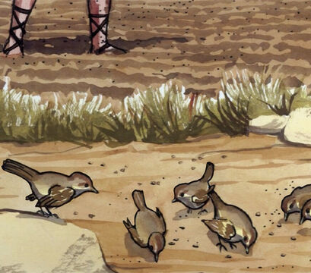
The Parable of the Sower Explained
Mark 4:15-20
15 And these are they by the way side, where the word is sown; but when they have heard, Satan cometh immediately, and taketh away the word that was sown in their hearts.

Slide 30
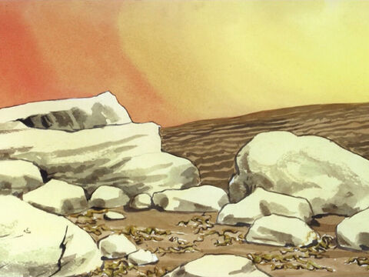
The Parable of the Sower Explained
Mark 4:16-20
16 And these are they likewise which are sown on stony ground; who, when they have heard the word, immediately receive it with gladness;

Slide 31
The Parable of the Sower Explained
Mark 4:17-20
17 And have no root in themselves, and so endure but for a time: afterward, when affliction or persecution ariseth for the word's sake, immediately they are offended.

Slide 32
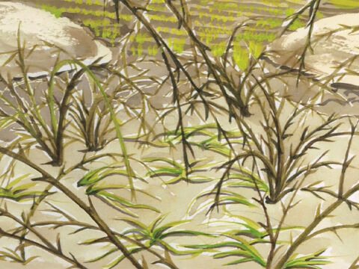
The Parable of the Sower Explained
Mark 4:18-20
18 And these are they which are sown among thorns; such as hear the word,

Slide 33
The Parable of the Sower Explained
Mark 4:19-20
19 And the cares of this world, and the deceitfulness of riches, and the lusts of other things entering in, choke the word, and it becometh unfruitful.

Slide 34
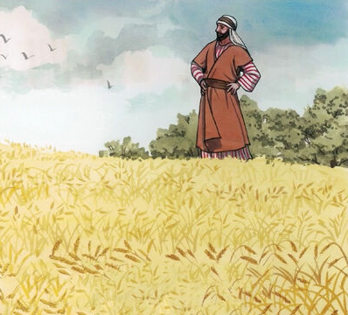
The Parable of the Sower Explained
Mark 4:20
20 And these are they which are sown on good ground; such as hear the word, and receive it, and bring forth fruit, some thirtyfold, some sixty, and some an hundred.

Slide 35
Christ’s Object Lessons, p. 36
“
So Christ, the heavenly Sower, went forth to sow…His servants in like manner must go forth to sow. When called to become a sower of the seed of truth, Abraham was bidden, “Get thee out of thy country, and from thy kindred, and from thy father's house, unto a land that I will show thee.” Genesis 12:1.
”

Slide 36
Christ’s Object Lessons, p. 36
“
“And he went out, not knowing whither he went.” Hebrews 11:8...So those who are called to unite with Christ must leave all, in order to follow Him. Old associations must be broken up, plans of life relinquished, earthly hopes surrendered. In toil and tears, in solitude, and through sacrifice, must the seed be sown.
”

Slide 37
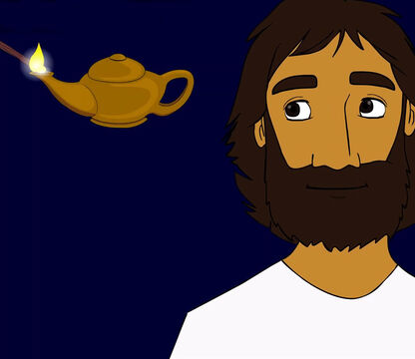
The Lamp
Mark 4:21-23
21 And he said unto them, Is a candle brought to be put under a bushel, or under a bed? and not to be set on a candlestick?

Slide 38
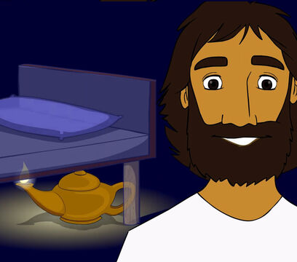
The Lamp
Mark 4:22-23
22 For there is nothing hid, which shall not be manifested; neither was any thing kept secret, but that it should come abroad.

Slide 39
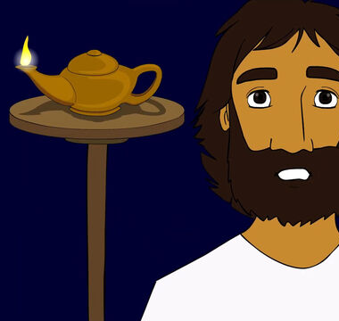
The Lamp
Mark 4:23
23 If any man have ears to hear, let him hear.

Slide 40
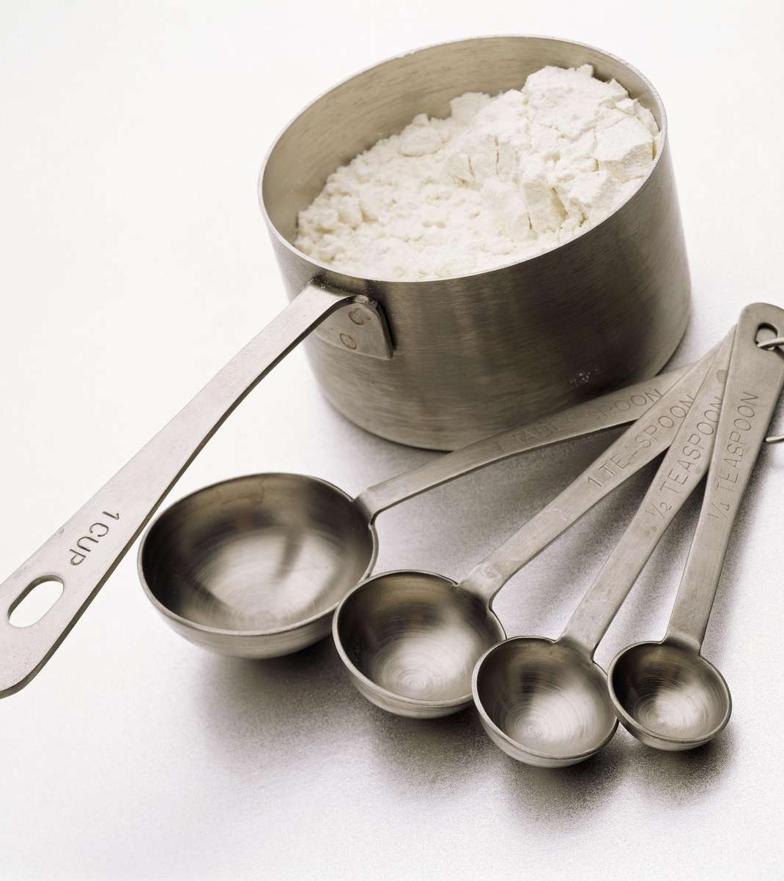
Measures
Mark 4:24-25
24 And he said unto them, Take heed what ye hear: with what measure ye mete, it shall be measured to you: and unto you that hear shall more be given.

Slide 41

Measures
Mark 4:25
25 For he that hath, to him shall be given: and he that hath not, from him shall be taken even that which he hath.

Slide 42
SDA Bible Commentary on Matthew 13:12
“
Those who have made practical use of the truth revealed to them will be given more truth. Those who are spiritually receptive will get infinitely more good from any presentation of truth than the keenest minds that are lacking in spiritual receptiveness. The wonderful gifts of Heaven are for those who eagerly desire them.
”

Slide 43
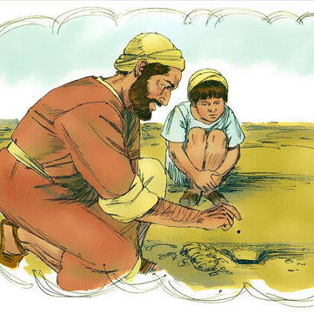
The Growing Seed
Mark 4:26-29
26 And he said, So is the kingdom of God, as if a man should cast seed into the ground;

Slide 44
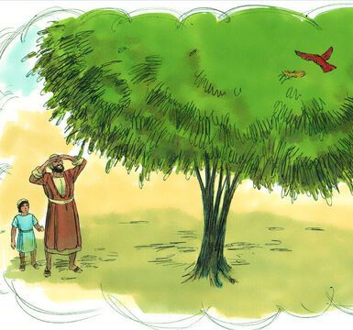
The Growing Seed
Mark 4:27-29
27 And should sleep, and rise night and day, and the seed should spring and grow up, he knoweth not how.

Slide 45
SDA Bible Commentary on Mark 4:26
“
In this parable Christ says that if the seed of the kingdom is but given a chance in the life, it will produce its harvest of good. Men may not be able to explain how the process of Christian growth and character transformation takes place, but it goes forward nevertheless.
”

Slide 46
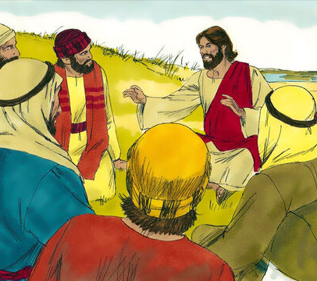
The Growing Seed
Mark 4:28-29
28 For the earth bringeth forth fruit of herself; first the blade, then the ear, after that the full corn in the ear.

Slide 47
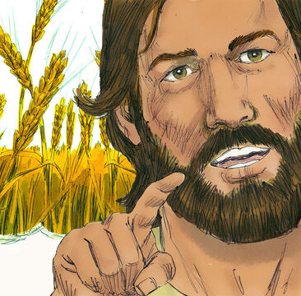
The Growing Seed
Mark 4:29
29 But when the fruit is brought forth, immediately he putteth in the sickle, because the harvest is come.

Slide 48
Christ’s Object Lessons, p. 38
“
Every seed brings forth fruit after its kind. Sow the seed under right conditions, and it will develop its own life in the plant. Receive into the soul by faith the incorruptible seed of the word, and it will bring forth a character and a life after the similitude of the character and the life of God.
”

Slide 49
Christ’s Object Lessons, p. 38
“
The teachers of Israel were not sowing the seed of the word of God. Christ's work as a teacher of truth was in marked contrast to that of the rabbis of His time. They dwelt upon traditions, upon human theories and speculations. Often that which man had taught and written about the word, they put in place of the word itself. Their teaching had no power to quicken the soul.
”

Slide 50
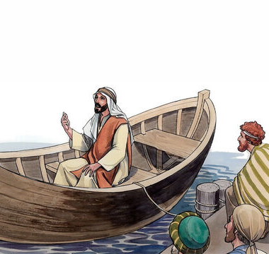
The Mustard Seed
Mark 4:30-32
30 And he said, Whereunto shall we liken the kingdom of God? or with what comparison shall we compare it?

Slide 51
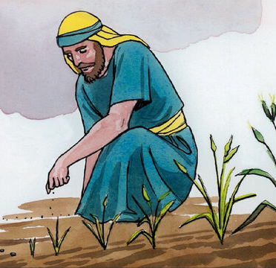
The Mustard Seed
Mark 4:31-32
31 It is like a grain of mustard seed, which, when it is sown in the earth, is less than all the seeds that be in the earth:

Slide 52
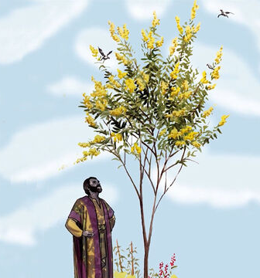
The Mustard Seed
Mark 4:32
32 But when it is sown, it groweth up, and becometh greater than all herbs, and shooteth out great branches; so that the fowls of the air may lodge under the shadow of it.

Slide 53
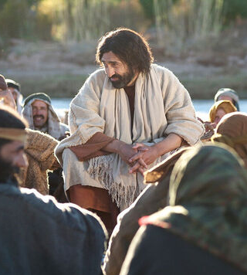
Parables
Mark 4:33-34
33 And with many such parables spake he the word unto them, as they were able to hear it.

Slide 54
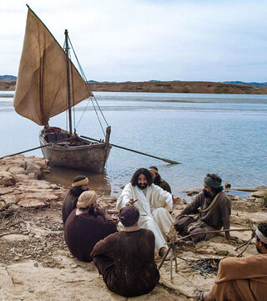
Parables
Mark 4:33-34
34 But without a parable spake he not unto them: and when they were alone, he expounded all things to his disciples.

Slide 55
Parable Questions
How to interpret what they mean,
Why Jesus used them,
What kind of lessons they were intended to reveal,
How literally they were to be taken,
Whether they were purely allegory.

Slide 56
Thank you!
Happy Sabbath!!

